Slide 2
Program Builder – Usability Readout
Sharon Byrd
01/16/2026
Notes:
Hello everyone. Thanks for joining on us for the Program Builder readout. We’re going to discuss what we learned about the design of this tool directly from the mouths of users.

Slide 3
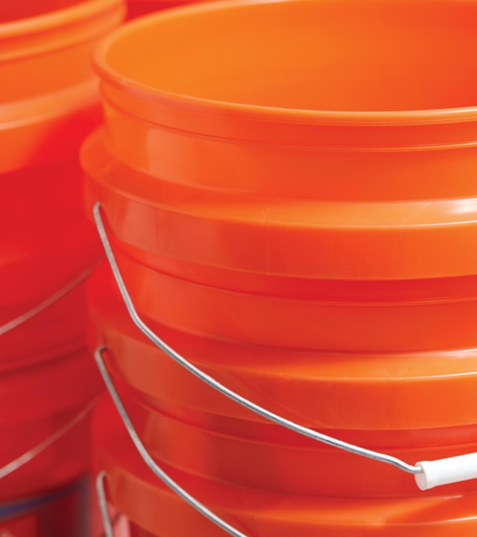




Program Builder
Agenda
Goals of the Usability Test
Methodology
Key Findings
Next Steps
Notes:
First we’ll go over the goals of the usability test. Then the methodology that we used. We’ll discuss the key findings and possible next steps. Alright, let’s jump right in.

Slide 4
Program Builder
Goals of the Usability Test
The purpose of this research was to evaluate the usability of Program Builder, a tool designed to streamline the creation and management of loyalty challenges. The specific opportunity was to ensure the tool is intuitive for users familiar with LMS and challenge-building workflows, reducing friction and improving adoption.
Main questions asked:
How do users create a new challenge?
Are required fields and steps easy to identify and complete?
Can users confidently add rewards and audiences?
How intuitive are editing and launching challenges?
Overall usability perception (SUS-based questions).
Notes:
The purpose of this research was to evaluate the overall usability of the Program Builder. This tool was designed to streamline the creation and management of loyalty challenges. We assessed whether users can create, edit, publish, and review challenges. We also wanted to Identify usability issues in navigation, labeling, and workflow, Measure the users confidence , reduce friction and improve adoption of the tool.

Slide 5

Program Builder
Methodology
We conducted remote moderated usability tests with five participants from Loyalty Marketing and the Operations teams. Each participant completed a series of tasks using a high-fidelity prototype, including creating a challenge, configuring steps (onboarding + transactions), attaching/creating rewards, and uploading an audience (BigQuery/CSV), reviewing, editing, and launching a challenge.
Notes:
We had 5 participants from the Loyalty Marketing and Operations teams. I gave them about 8 tasks to complete and and observed how they completed the tasks. I asked them to think outloud as they went along. Why did you click on that? How difficult was it to complete that task? Was there anything that you felt was confusing? Let’s talk about it. Then 10 post-assessment questions were asked to create a SUS (system usability scale) score.
SUS questions:
I think that I would like to use this system frequently.
I found the system unnecessarily complex. (negative)
I thought the system was easy to use.
I think that I would need the support of a technical person to be able to use this system. (negative)
I found the various functions in this system were well integrated.
I thought there was too much inconsistency in this system. (negative)
I would imagine that most people would learn to use this system very quickly.
I found the system very cumbersome to use. (negative)
I felt very confident using the system.
I needed to learn a lot of things before I could get going with this system. (negative)
This method was chosen because:
It allows observation of real-time
decision-making and pain points.
Participants are actual end-users with varying experience levels.
Prototype testing identifies design issues early before development begins.
Concept testing validates an idea's appeal and viability early on (the "what" and "why"), while usability testing evaluates how easy and efficient a built product is to use (the "how"), finding pain points and improving the user experience (UX) before or after launch. Concept testing is for validation, focusing on market fit and perceived value, whereas usability testing is for optimization, focusing on functionality and user interaction.

Slide 6

Key Findings
What: Usability Testing for Program Builder
When: 12/17 – 1/7
Who: 5 Users from Marketing & Operations
On overall usability
“Definitely easy to use, intuitive. Everything flowed exactly how I thought it would.”
Insights
Pain Points
Recommendations
SUS Score
Found the system intuitive and easy to navigate.
Felt confident using the tool without technical support.
Labels and required fields were clear.
Excited and willing to use the system frequently.
Good cohesion with system integration.
Labels like “Challenge Builder” and “Challenge Library” were self-explanatory.
Drag-and-drop functionality to reorder steps was intuitive.
Options to attach or create rewards were clear
Audience upload process was clear.
Possible learning curve for brand new users
Expected a “New Challenge” label instead of “Challenge Builder”
Reward creation fields (title, short title, description) seemed repetitive and confusing.
Expected reward creation to auto-save after pressing “Continue” but needed to click “Create Reward” first.
Feedback messages were too brief, reducing user confidence in task completion.
Download template link for audience creation was not prominent.
Place a ”Create a challenge” or “New Challenge” button directly on the homepage.
Add progress indicators and checkmarks for completed steps.
Reduce redundancy or provide tooltips explaining differences between “Title,” “Short Title,” and “Description.”
Make CSV template link more prominent.
Allow users to save progress before final submission for review or approval.
Provide explicit success confirmation and summary after launching a challenge.
Align button labels with user expectations (e.g., “Launch Challenge” instead of “Submit”).
86.25 (A+)
A SUS (System Usability Scale) score (0-100) indicates perceived usability, with 65 being the average; above 68 is above average.
In May 2025, the Challenges Concept Builder (Onboarding Challenge) was tested and received an 84.4 (A+)
SUS score.
Previously the LMS Rewards SUS score was 51.8 (D).

Slide 7
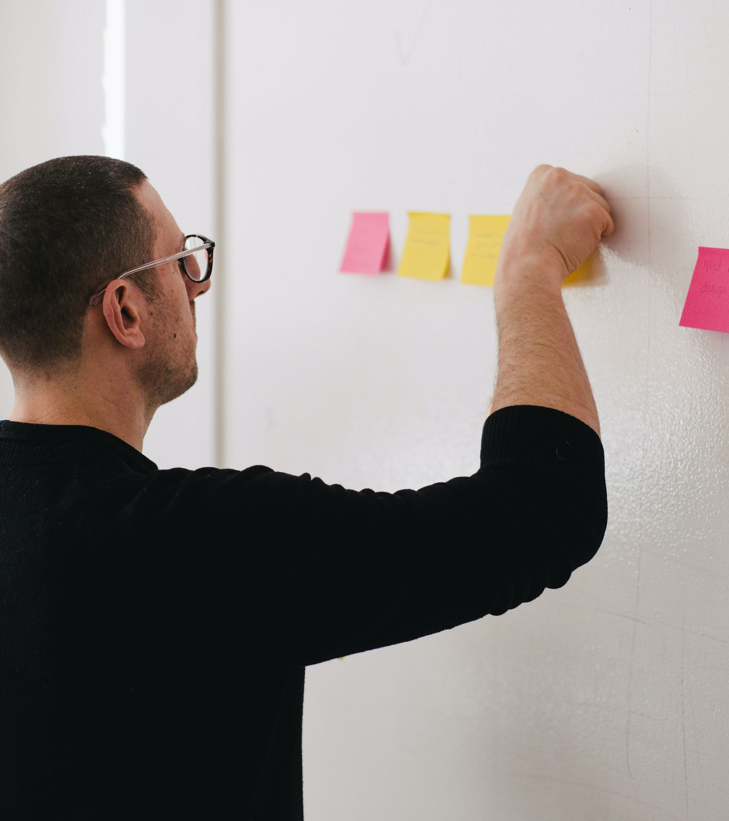
Next Steps:
UX team:
Implement recommended UI changes in the upcoming iterations.
Engineering team:
Persistent success messages and inline reward creation.
Future state enhancements:
Save draft of challenge.
Continued Feedback:
Conduct post-launch tests and surveys with experienced and novice users.

Slide 11

Links to User Research
Links to User Interviews:
Participant #1
Participant #2
Participant #3
Participant #4
Participant #5
Usability Test Feedback:
Miro Board
High-Fidelity Prototype:
Figma Prototype
High-Fidelity Prototype:
Figma Mocks

